Slide 1
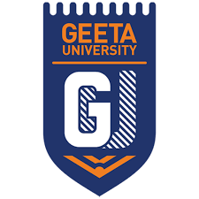
Geeta University Panipat
Topic: Generative Ai
Submitted To:
Mr. Rajnikant Gupta
Submitted By:
Milly jain
2301301054
B.Tech Cse (A)

Slide 2
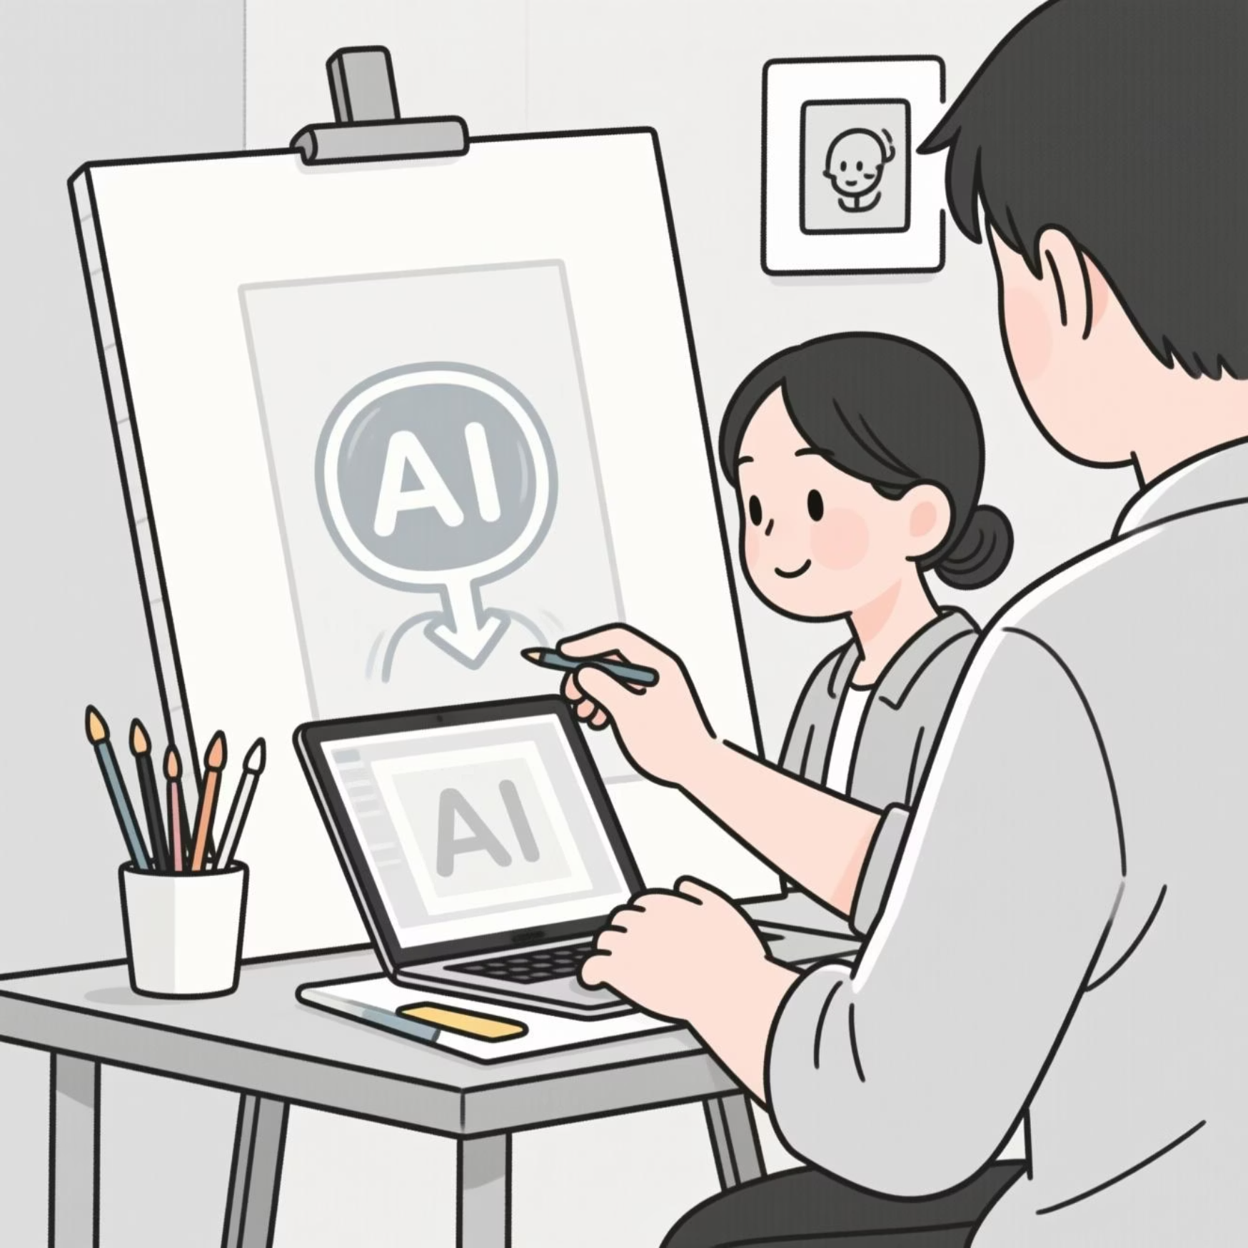

What Is Generative AI?
Generative AI is a type of Artificial Intelligence that can create new content — such as text, images, music, video, or code — based on user prompts.
Unlike traditional AI, which only analyzes or classifies data, Generative AI produces original outputs similar to human-created content.
Examples include ChatGPT (text generation), DALL·E (image creation)

Slide 3

The Core Technology of Generative AI
01
02
03
Large Language Models
Unsupervised Learning
Pattern Synthesis
Systems like GPT utilize transformer architectures with billions of parameters, processing language at unprecedented scale and sophistication.
Models train on vast datasets—billions of documents, images, and media—learning patterns without explicit instruction.
Advanced algorithms predict and synthesize content by understanding context, style, and structure, mimicking human creativity and reasoning.
Modern generative models can contain over 175 billion parameters, trained on datasets encompassing a significant portion of humanity's written knowledge.

Slide 4
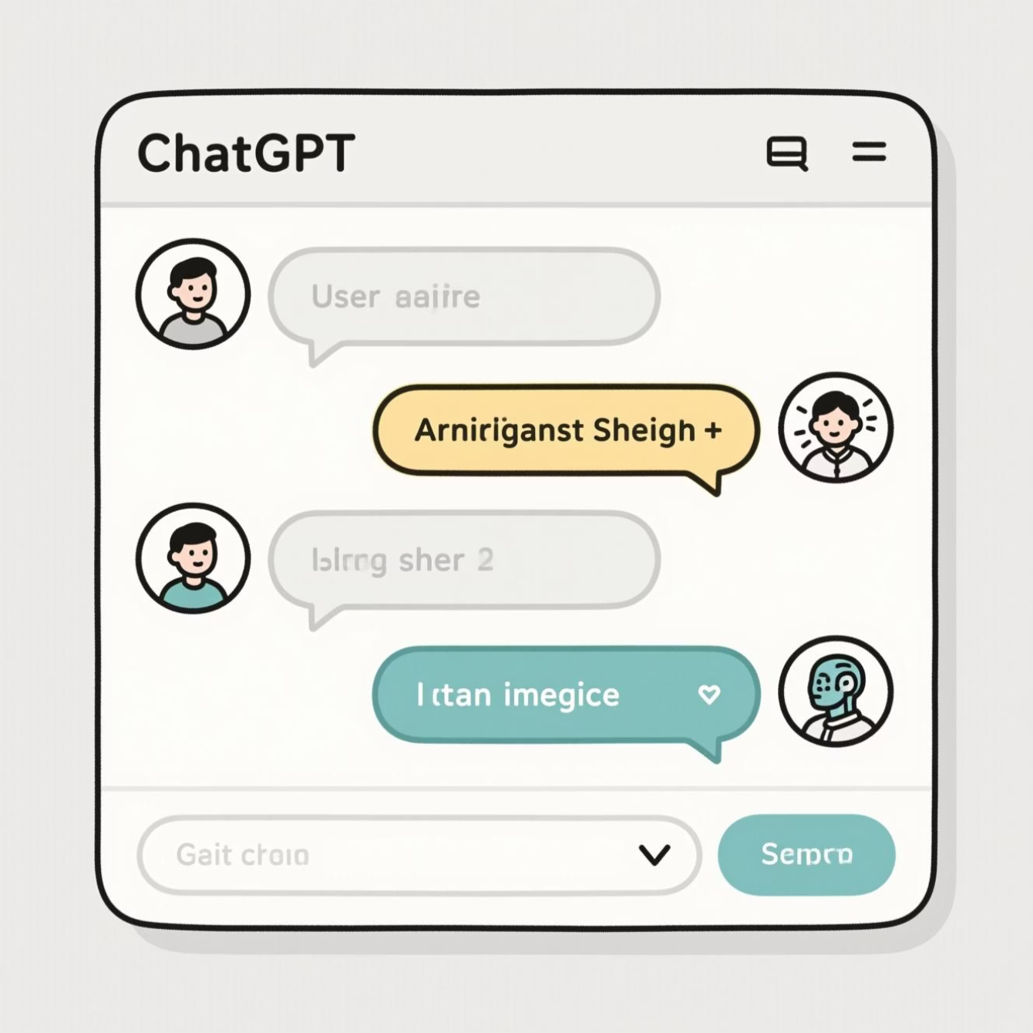
Case Study – OpenAI's ChatGPT
Developed by: OpenAI, launched in November 2022
Technology Used: Generative Pre-trained Transformer (GPT) architecture
Function: Produces human-like text responses — can write essays, code, emails, and more
Training: Trained on vast internet text data and refined using Reinforcement Learning from Human Feedback (RLHF)
Impact: Over 100 million users in 2 months — fastest-growing app in history
Fastest-growing consumer app ever
Conversations processed globally
Neural network connections

Slide 5




How It Works / Implementation
User Input
A prompt or query is submitted in natural language, providing context and instructions for the desired output.
Neural Processing
The model tokenizes input, processes it through multiple transformer layers, analyzing patterns and context from its training data.
Content Generation
Using probability distributions, the system predicts and generates the most appropriate response token by token.
Refined Output
The generated content is decoded and presented, refined through techniques like reinforcement learning from human feedback.

Slide 6
Real-World Applications
Generative AI is reshaping industries and workflows across the global economy, creating new possibilities in virtually every sector.
Healthcare
Education
Business
Creative Industries
Drug discovery, medical imaging analysis, personalized treatment plans, and clinical documentation.
Personalized tutoring, content creation, adaptive learning systems, and automated grading assistance.
Market analysis, customer service automation, strategic planning, and data-driven decision making.
Graphic design, content writing, music composition, video production, and advertising campaigns.

Slide 7
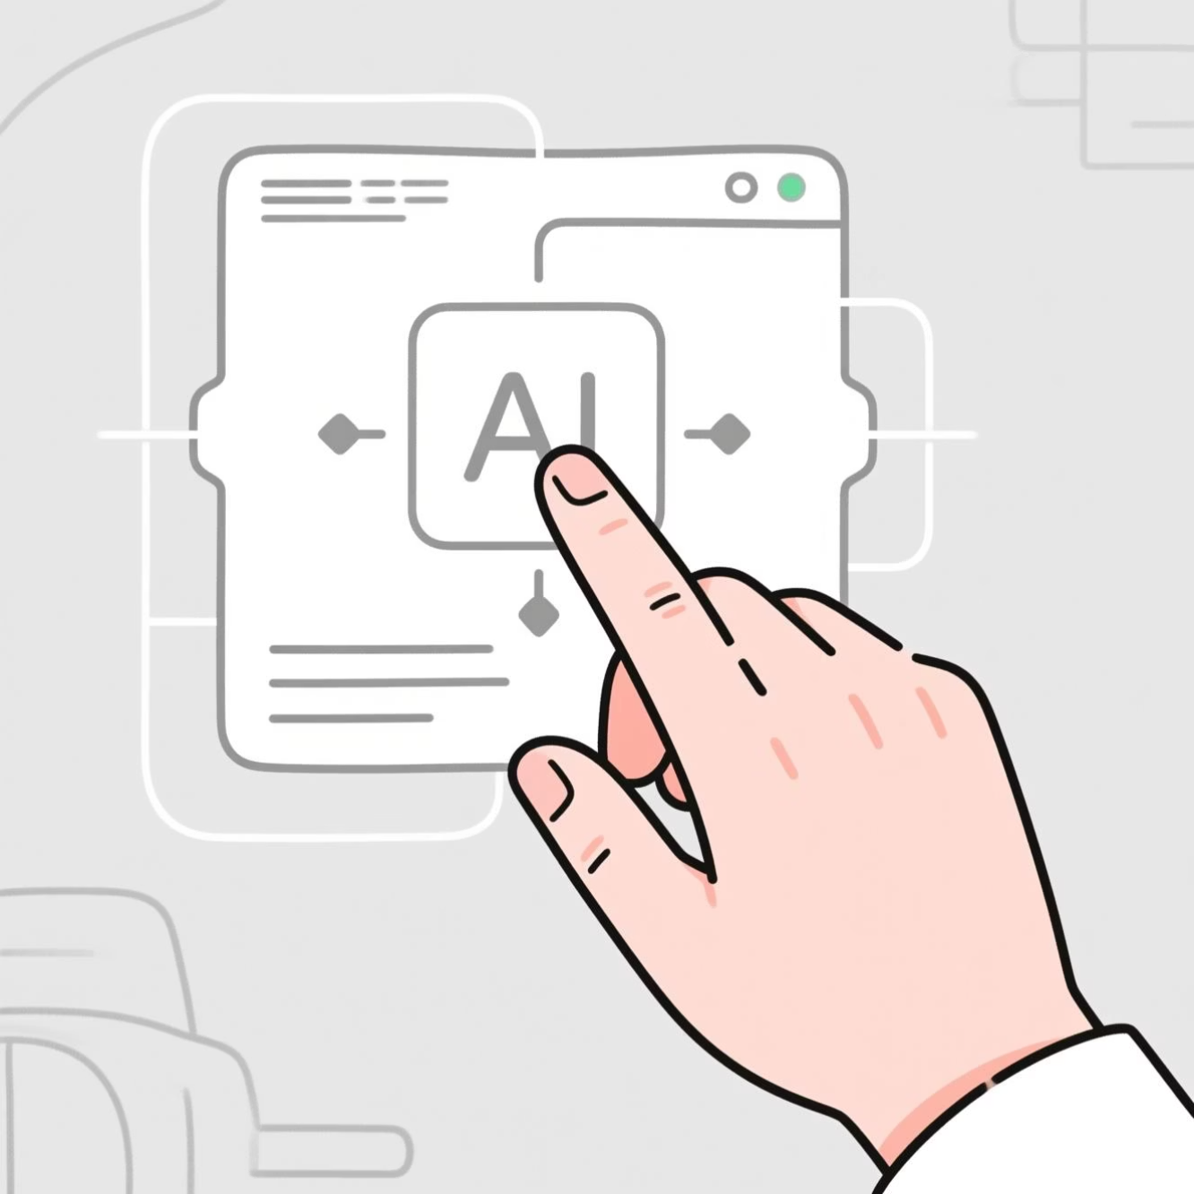
Conclusion
Generative AI is transforming the world around us — from how we learn, work, and create, to how we interact with technology every day.
It’s helping in education, business, healthcare, and creativity, making tasks faster and smarter. However, we must also use it responsibly to avoid misuse and ensure fairness.
Generative AI is not just the future — it’s already changing our present.

Slide 8


